Slide 1
The ADARA Project
Presented to
SNS/ESS Workshop on Opportunities for Accelerating Neutron Data Analysis
Galen Shipman Data System Architect Computing and Computational Sciences
June 28, 2012

Slide 2
Our Mission… what do we aspire to do?
SNS is an experimental facility – users come here to do experiments
Collect the most (appropriate) data during their beam time
Understand that data as much as possible/practical
Post-acquisition (could be 1 min, 1 month, 1 year later) – users need to manipulate (reduce/analyze/visualize/model) their data to get the scientific content – and for most scientists this is an “interactive” process.
What should we aspire to… create a data infrastructure that gives users
The ability to reduce, and analyze, the data as it is taken
Data files created instantly after acquisition (no matter how big)
The ability to reduce a data set post-acquisition in ~1 minute
The resources for any user to do post-acquisition reduction, analysis, visualization, modeling from anywhere…
Surely everyone signs up to these… but how does one make it happen

Slide 3
Data Acquisition, Translation, and Reduction Today
Data acquisition currently based on a pipeline of file generation and transformation
Neutron events, PulseIDs, slow controls logs are dumped into separate flat files during the experiment run
Upon completion of an experiment these separate flat files are copied to another system and data translation begins
Conversion to NeXus format
Once Translation completes the NeXus files are copied to a common repository
Translation can take minutes to hours to complete following the experiment completion
Data reduction begins once NeXus files are created
Mantid is used to reduce the neutron data in the NeXus file
Reduced data then copied to a common repository
Reduction can take seconds to hours to complete following Translation completion
Users may have to wait for a day or more before they are able to begin interactive analysis with large datasets
Translation and reduction may fall behind during series of short back-to-back experiments

Slide 4
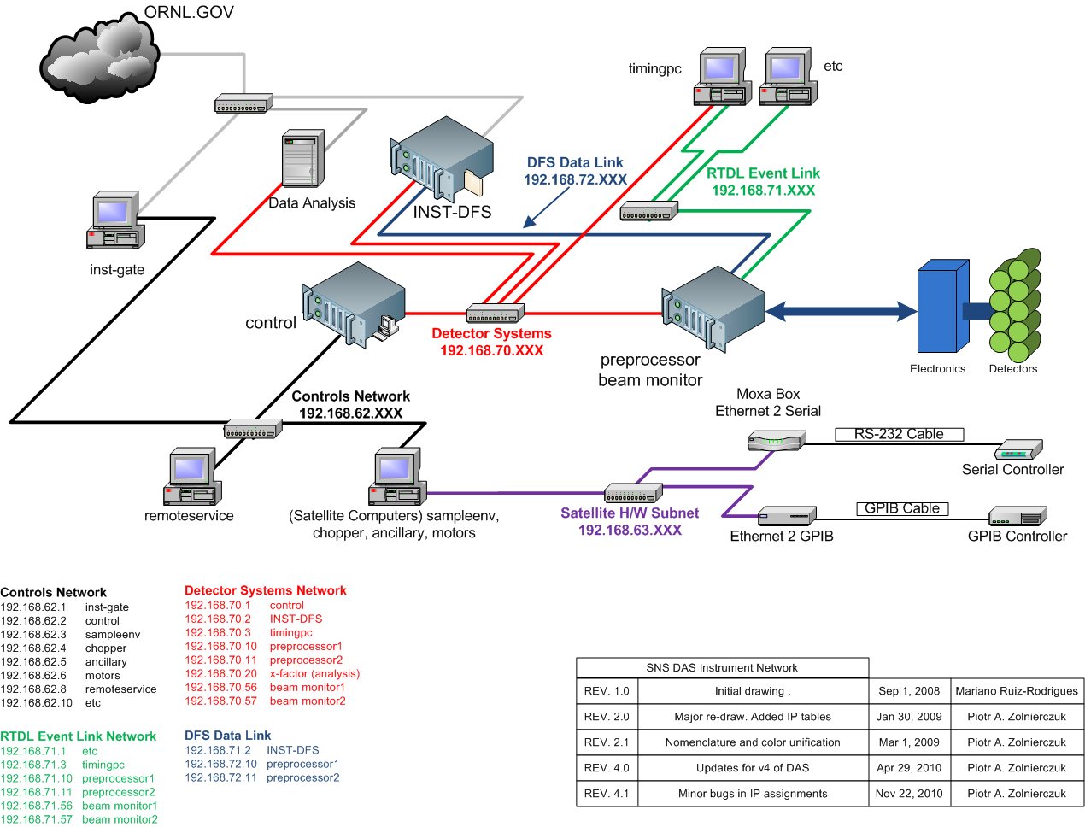
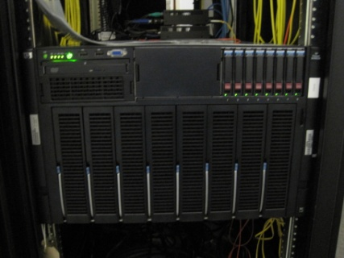
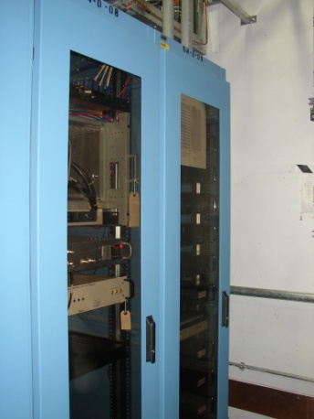
Even Without These Challenges, DAS Needs to be Upgraded
Parts of the SNS DAS have to be upgraded for obsolescence/maintainability
Many elements can be streamlined
New capabilities can be realized

Slide 5
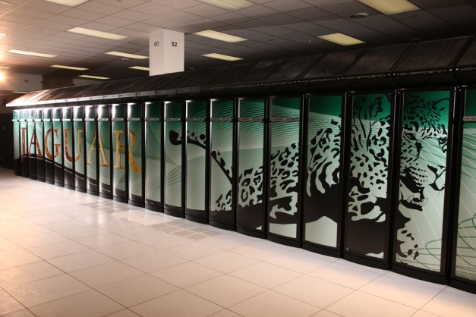
What Mechanisms are Needed?
Ability to stream neutron data to any number of downstream consumers
Live reduction of neutron data as it is being generated – Instant feedback to
scientists
Translation of neutron data to NeXus files as it is being generated - NeXus files
the instant the experiment is complete
NeXus files created and stored in a high-performance parallel file system
co-located with a high-performance compute cluster for timely post-analysis
Parallel reduction and
analysis operators

Slide 6
What Components Are Required
Event
Detectors
sftp, scp, smb, etc
DAS
Pre-Preprocessor
STS
SMS
Slow Controls
PV Streamer
I/O System
Lustre PFS
NeXus Files
Reduced Files
SRS
Job Control
Mantid
Fermi Cluster
Slow controls
Parallel Reduction Job Submissions
A publish/subscribe system in which neutron data can be aggregated and
rebroadcast in real time in a common network format to multiple downstream
consumers – Stream Management Service (SMS)
A data translation system that can organize raw data received from the SMS into the
NeXus data format – Streaming Translation Service (STS)
A data reduction system that converts raw data received from the SMS to a
scientifically convenient representation – Streaming Reduction Service (SRS)

Slide 7
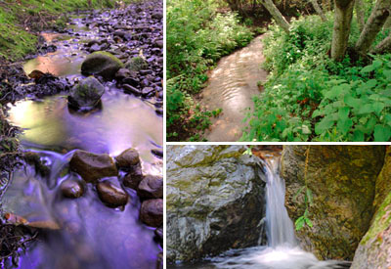
The Stream Management Service
A High Performance Publish/Subscribe System
Data is aggregated from a number of sources,
transformed and streamed in a common
network format
As data is aggregated and transformed it is
stored locally allowing subscribers to join the
the stream at any time
Can service a relatively large number of
downstream subscribers concurrently
Subscribers can consume neutron data at
different rates, SMS will manage buffering
Provides a common communication backplane
for reduction, translation, and in the, future
coupling to simulation

Slide 8
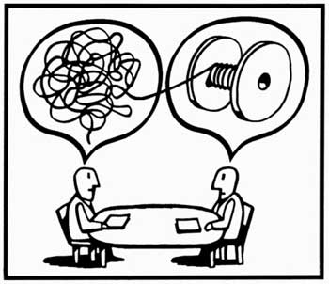
The Streaming Translation Service
A downstream subscriber to the SMS
During experiment run startup SMS connects to the STS
and negotiates translation processing
STS begins translation as data is received from the
SMS using a small amount of buffering, translating
that buffer and then writing out that buffer within the
NeXus HDF5 file
A single NeXus file is written over the course of
the experiment and upon completion of the
experiment the NeXus file is archived/cataloged
Translation of even extremely large datasets will
complete mere moments after the experiment is
finished
NeXus files will instantly be available in a high-performance parallel file
system allowing parallel capable reduction and analysis operators for
post-processing

Slide 9
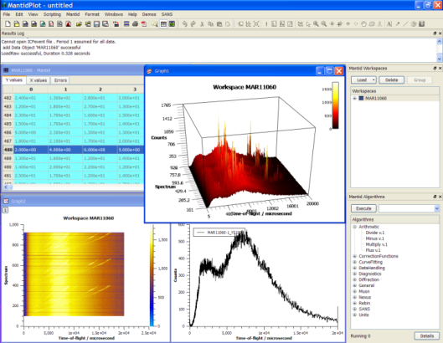
The Streaming Reduction Service
A downstream subscriber to the SMS built upon Mantid
During experiment start SRS connects to the SMS
and begins receiving neutron data
From within Mantid the user can interactively set
a number of parameters for reduction such as
binning, plotting type, etc..
Data is reduced in real-time and displayed within
a Mantid workspace
Concurrently users can reduce other datasets
and visualize the results for comparison with previous experiments
Parallel reduction operators can be concurrently executed on HPC clusters
for timely re-reduction of extremely large-datasets allowing inter-comparison
of these large datasets with the live stream
SRS can subscribe to multiple neutron data streams concurrently allowing
multiple experiments to be reduced concurrently or a single experiment
reduced using different operators within Mantid

Slide 10
ADARA – Accelerating Data Acquisition, Reduction and Analysis
Collaboration – NDAV, Technology Integration Group (NCCS), DAS/RAD
Enabling real-time analysis and computational steering
Detector
Streaming data reduction and analysis
Data portals
Electronics
Stream management
Translation services
Pre- processor(s)
Global high- performance file system
Sample environment control/scanning
Analysis clusters
Data acquisition: Resources at each beam line
Data analysis: Shared resources
User interface
Analysis workstations

Slide 11
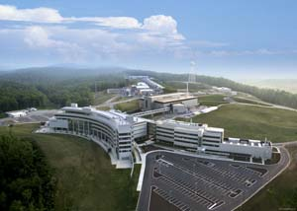
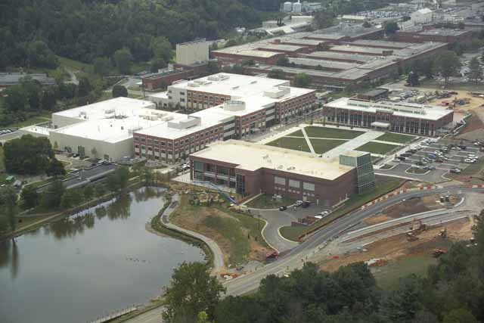
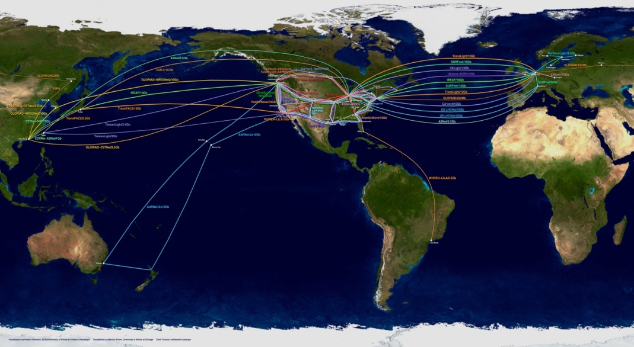
Enabling the future…
ADARA lays foundations for things we can do in the future…
Live data analysis/computational steering (multi-level):
Instrument level – GSAS fit on POWGEN or Lorentzians on BASIS makes decision to move to next temperature etc.
Run a simulation on Jaguar (or Titan) in real time to steer an experiment
Develop a program that lets SNS/HFIR (experimental) users leverage HPC resources for analysis/modeling at OLCF/NERSC etc. (previous slide) but how do we also…
Engage theory/modeling/simulation to drive research at SNS/HFIR on the “big” problems…
ORNL has established simulation/theory groups
What about collaboration with non-ORNL groups
Establish a (small) theory group and employ online collaboration tools similar to CASL??
Funding for collaborative projects with other theory groups
Collaboration with CCSD on “applied Math” topics
Fitting and optimization problems
Higher dimensional visualization

Slide 12
Stream Management
Presented to
SNS/ESS Workshop on Accelerating
Neutron Data Analysis
David Dillow
Advanced Systems Architect & Developer
National Center for Computational Science
June 28, 2012

Slide 13
Design Goals
One-stop shopping for clients to obtain data from instrument
Provide flight-recorder capabilities
Low maintenance
Stand-alone data files
High performance with multiple clients
Flexible, extensible data format

Slide 14
Shop Smart, Shop DataMart
Multiple sources of information for an instrument
Beam monitors
Detectors
Sample environment
Tracking information
Clients should not need to know how to find each data source

Slide 15
Where did I put that notebook?
Eliminate requirement of external knowledge of the system
Clients should be able to refer to the stream for all data needs
Should not need to know that pixel ID 78991 indicates the phase of the T0 chopper
Instrument geometry should not be separate from event data

Slide 16
SMS Aggregation
SMS aggregates all data into single stream
Event data
Sample environment
Proposal/Run information
Beamline Configuration
Output stream is approximately ordered by time
Multiple detector systems synchronized by pulse id
Sample environment updates added in near-realtime

Slide 17
Instrument Flight Recorder
Even the best users make mistakes
Oh, hey, that was interesting!
Did I start recording before going to breakfast?
SMS is always recording data
User determines destination
Not in a run: stored locally
In a run: also goes to STS to be converted to NeXus

Slide 18
Avoiding the 3AM call
We generate lots of data
Some instruments generate 8 to 16 MB/s
Always recording
Finite disk space!
SMS automatically purges old data
Aims for 2+ week retention
Data from runs protected until converted to NeXus

Slide 19
SMS Data Files
Instrument data is internally stored as append-only files
We change files on run start/stop
We change files when we grow too large
Multiple files is an implementation detail
STS and live clients see single stream
A run generates a single NeXus file

Slide 20
Why Multiple Files Internally?
Limiting size of files smooths space reclamation
Recovery no longer “all or nothing”
Larger window to recover coherent partial data
Having multiple files requires more state snapshots
Each file must stand alone
Beginning of each file contains complete state information

Slide 21
Events for Everyone!
SMS supports multiple simultaneous clients
Clients can join and leave at any time
Each client can consume at different rate
Streams are buffered on-disk, so SMS can tolerate a significant backlog to clients
Clients can choose to see historical data
Configurable granularity
Receive system snapshot as of replay point

Slide 22
SMS Performance
Multiple clients with low CPU overhead
Zero copy network stack
Currently limited by disk performance
Easily streams 600 Mevents/s
Single SATA disk
Multiple fast readers on loopback

Slide 23
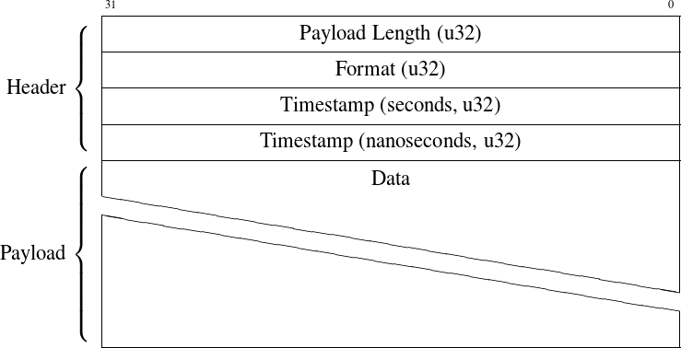
ADARA Packet Header

Slide 24
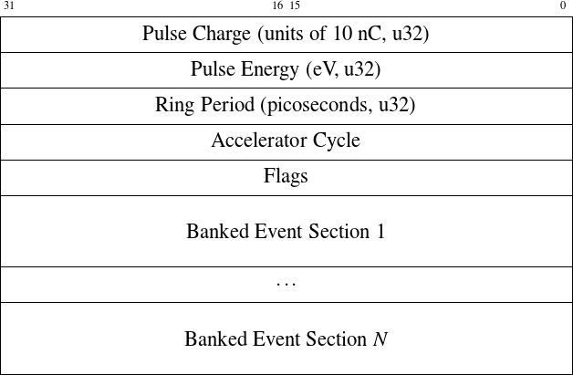
Banked Event Payload

Slide 25
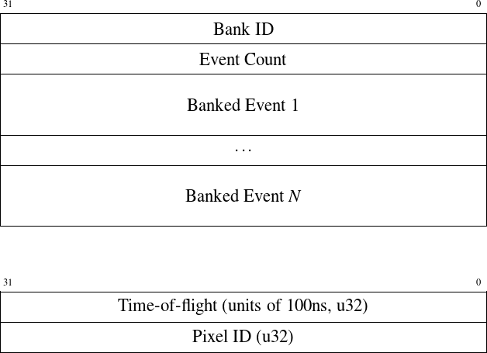
Banked Event Sections

Slide 26
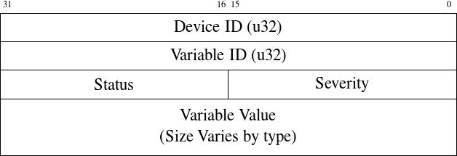
Variable Update Payload

Slide 27
Creating Data Files On-the-Fly at SNS:  Streaming Translation Service 
STS!
James A. (“Jeeem” ☺) Kohl, PhD
Instrument Controls & File Translation, Team Lead
Instrument Data Acquisition & Controls Group
Spallation Neutron Source, ORNL
June 28, 2012

Slide 28
Where we have been…
Archive
& Catalog
Pre-2011…
Neutron Experiment
Copy
Data
NeXus File
Generation
Copy
Data
(again)
time
…by July 2011
Neutron Experiment
Copy
Data
NeXus
Parallel File Copy (SVCP)
HistoTools Optimization
Split Raw/NeXus Handling
What the Users Really Want…! ☺
Neutron Experiment
“Your Data is Available!”

Slide 29
Approach: “Don’t Just Optimize, Stream It!”
Don’t Wait for ‘Post Mortem’ data processing & analysis
Incrementally collate data and write to NeXus file
Take advantage of Neutron Pulse “Independence” (& Live Viewing!)
Minimal “Last-Minute” Post-Processing for Final Delivery
Archive (in place) and Catalog ~ Copy-of-Record Data…
wait
time
HistoTools 3.4
HistoTools 4.0
ADARA!
progress...

Slide 30
Current Live Data Processing (LDP)
Beamline Analysis Computer
DAS
“Gate”
MySQL
Live Geometry (3306)
MySQL
LDP
Event
Catcher
(a.k.a. “Slow Controls” Meta-Data…)
Commands (8003)
UDP
Data (8002)
/SNS/<INST>/shared/live
DAS
PreProc
DAS
PreProc
DAS
PreProc
Commands (8003)
DAS
Data File
Server
DFS
BSS_2011_10_06T16_30_19Z_histo.nxs (HDF5)
BSS_17511_live_neutron_event.dat (Raw)
BSS_17511_live_pulseid.dat (Raw)
BSS_geom_2011_10_06T15_27_57Z.nxs (XML)
BSS_timemap_2011_09_28T12_01_44Z.dat (Raw)
. . .
Data (8002)
TCP
Packet Header:
int32_t iReceiveID (seq#)
int32_t iCommandID
int32_t iTotalBytes
int32_t Spare1 (Payload Bytes)
int32_t Spare2 (unused)
int32_t Spare3 (Detector Bank)
Command IDs:
STARTALL 0x100
STOPALL 0x101
PAUSEALL 0x102
RESUMEALL 0x106
SAVEDATA 0x201
PulseId Struct:
uint32_t pulseIDlow (nano)
uint32_t pulseIDhigh (sec)
uint64_t eventID (index)
double charge
Neutron Event Struct:
uint32_t tof
uint32_t pixelId

Slide 31
Current Translation Service (TS)
DAS
Data File
Server
(DFS)
“Slow Controls”
Meta-Data
(cvinfo.xml)
CIFS (Samba)
Beamline
Analysis
Computer
Translation
Client
Neutron
Events
Pulses
HistoTools
(NeXus)
/SNSlocal
BSS_2011_10_06T16_30_19Z_histo.nxs (HDF5)
BSS_17511_live_neutron_event.dat (Raw)
BSS_17511_live_pulseid.dat (Raw)
BSS_geom_2011_10_06T15_27_57Z.nxs (XML)
BSS_timemap_2011_09_28T12_01_44Z.dat (Raw)
. . .
Translation
Server
DATA ARCHIVE
/SNS/<INST>/IPTS-<ddd>/<Collection>/<Run>/
NeXus/BSS_12345_event.nxs (HDF5)
NeXus/BSS_12345_histo.nxs (HDF5)
preNeXus/BSS_12345_neutron0_event.dat (Raw)
preNeXus/BSS_12345_pulseid0.dat (Raw)
preNeXus/BSS_cvinfo.xml (XML)
preNeXus/BSS_12345_runinfo.xml (XML)
preNeXus/BSS_12345_bmon3_histo.dat (Raw)
preNeXus/BSS_beamtimeinfo.xml
. . .
DATA CATALOG
ICAT
VFS
SNS NeXus
Live Catalog

Slide 32
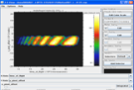
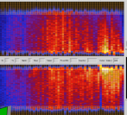
ADARA Streaming Architecture
DAS Control Computer
Central Translation
DAS
PreProc
DAS
PreProc
ADARA
Hybrid
Network
Protocol
Streaming Translation
Service
(STS)
DAS
PreProc
Stream
Management
Service
(SMS)
TCP
DAS
“Fast”
Meta-Data
NeXus
DAS
“Slow”
Controls
Analysis Computer
(HNP)
Streaming Reduction
Service
(SRS)
*NEW*
DATA ARCHIVE
(Geometry,
Sample Env
Meta-Data…)
/SNS/<INST>/IPTS-<ddd>/
“Live
Viewing”
nexus/BSS_12345.nxs.h5 (HDF5)
nexus/BSS_12346.nxs.h5 (HDF5)
. . .
raw/BSS_12345.adara (Raw)
raw/BSS_12346.adara (Raw)
. . .
DATA CATALOG
ICAT
VFS
Live
Catalog

Slide 33
ADARA Streaming Translation Service (STS)
Central Translation
SMS
(HNP)
Protocol
Engine
NeXus Generator
(Events, Fast-Meta, Slow Ctrls)
Streaming Translation
Part 1
(Live Collection
+ HistoTools)
(RunInfo,
Geom/IDF,
Device Desc)
H5NX
XML
Parser
NeXus
*NEW*
DATA ARCHIVE
* Incremental File Write & Flush On-the-Fly…
- “Constant” Memory Footprint
* Custom HDF5-based NeXus API
- Multiple open datasets & flushing
/SNS/<INST>/IPTS-<ddd>/
nexus/BSS_12345.nxs.h5 (HDF5)
nexus/BSS_12346.nxs.h5 (HDF5)
. . .
raw/BSS_12345.adara (Raw)
raw/BSS_12346.adara (Raw)
. . .
DATA CATALOG
ICAT
VFS
Live
Catalog

Slide 34
“Hysterical” Beamline Configuration: Mapping Files
Neutron Event Detector “Pixel Ids”
Map DAS “Physical” Pixel Ids to Analysis “Logical” Pixel Ids
Arbitrary Chaos (based on physical layout) to Orderly Numbering
1
3
5
7
9
8
6
4
2
0
.
.
.
.
.
.
.
.
.
.
.
.
.
.
.
0 1 2 3 4 5 6 7 8 9
10 11 12 13 14 15 16 17 18 19
20 21 22 23 24 25 26 27 28 29
30 31 32 33 34 35 36 37 38 39
. . .

Slide 35
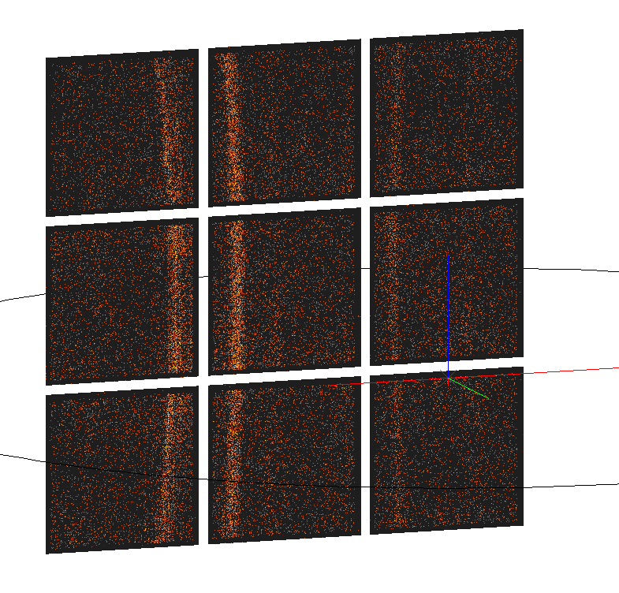
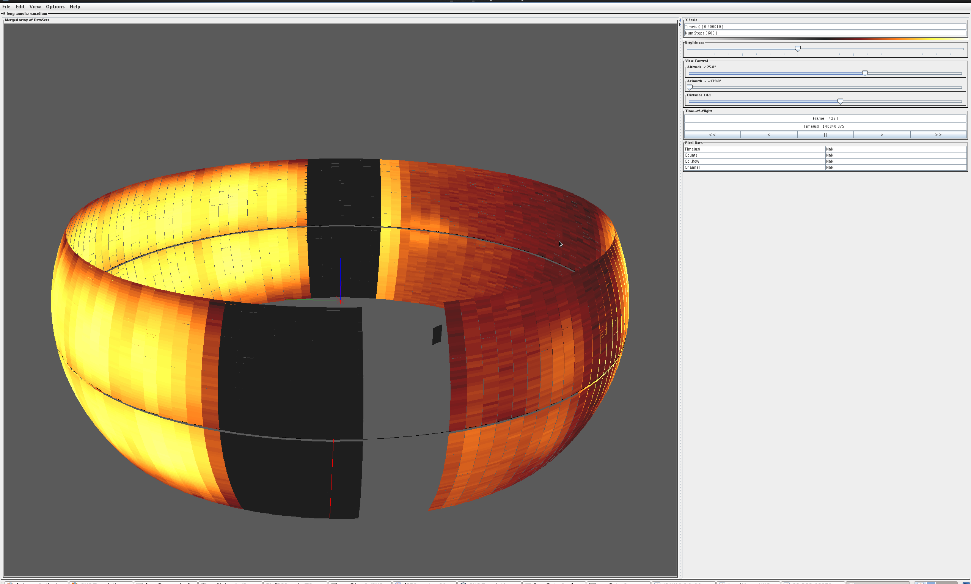
“Hysterical” Beamline Configuration: Banking Files
Neutron Event Detector Bank Organization
Number & Index of Detector Banks (e.g. “bank23”, “bank25”…)
Size of Each Detector Bank
Starting & Ending Pixel Id Indices (Contiguous vs. Arbitrary Lists!)
(Phony) Rectangular “Aspect Ratio” for Canonical Views… ☺
<banking>
<facility>SNS</facility>
<instrument>SNAP</instrument>
<date>2010-08-20</date>
<bank>
<number>3</number>
<x_size>256</x_size>
<y_size>256</y_size>
<continuous_list>
<start>1114112</start>
<stop>1179647</stop>
</continuous_list>
. . .
<arbitrary>
1,3,8-10,27
</arbitrary>
</bank>
. . .
</banking>
Never
Use
This!

Slide 36
New ADARA Beamline Configuration: Pixel Mapping Table
One-Time Merging of Mapping and Banking Files into Lookup Table
Single Associative Index does:
Pixel Id Mapping (DAS Physical → Analysis Logical)
Detector Bank Lookup (which Bank is this Neutron Event in…?)
Used to produce “Banked Event Data Packet” (HNP) at SMS stage! ☺
Greatly Simplifies STS collating of Neutron Events
Just Drop Blocks of Events into NeXus file structure
Associative Lookup Table:
DAS Physical Pixel Id
Logical Pixel Id
Bank Number
DAS Physical Pixel Id
Logical Pixel Id
Bank Number
DAS Physical Pixel Id
Logical Pixel Id
Bank Number

Slide 37

STS Preliminary Results
Core Functionality
Process Connection, Basic Run Info and Banked Event Data Packets
Drive by Raw Input File, Test Harness or SMS Prototype
Produces Valid NeXus files, Match Historical “Golden Data”
Performance
Potential Beamline Rates could reach 1-2 Million Neutron Events/second
Preliminary Bandwidth Peaks at 25 MB/sec (Well Over 3M events/sec!)
Yet to do:
Incorporate Slow Controls into DAS Logs
Device Descriptor (XML) (& “Device Groups”)
Process Variable Updates
Geometry Calculation & Integration (with IDF) into NeXus files

Slide 38
Enabling Live Data Reduction in Mantid
Presented to
SNS/ESS Workshop on Opportunities for Accelerating Neutron Data Analysis
Stuart Campbell Neutron Data Analysis & Visualization Neutron Science Directorate
June 28, 2012

Slide 39
Why Bother ?
Monitoring experiment
Raw data (e.g. monitor plots, alignment scans, etc…)
Reduced data (e.g. S(Q,ω), etc…)
Experimental steering
Provide user with more information to make better use of beam time
Automatic feedback to Data Acquisition System

Slide 40
Why Use Mantid?
Standard framework for data reduction
Event aware
Provides visualisation tools
(plots update automatically)
Easy to customize and extend.
Notes:
Plots update automatically

Slide 41
Data Flow
Listener reads from stream
Process Data ‘Chunk’
Accumulate into workspace
Do Post Processing (if required)
Update Output Workspace

Slide 42
Listener
Output workspace
Processing
Event Buffer
Algorithm
Load Live Data
Post Process
NO
Python
YES
Post Processing
Algorithm
Output workspace
Accumulation workspace
Python
Notes:
Listener design separates facility and DAS specific code in one plugin replaceable location

Slide 43
Live Listener Plugins
SNS – event Listener for SMS
Choose starting point (now, start of current run or a specified time)
ISIS Histogram Listener
ISIS Event Listener (to be developed)
Dummy Listeners for testing/development
Random Events
Replay historic data (neutron event files)

Slide 44
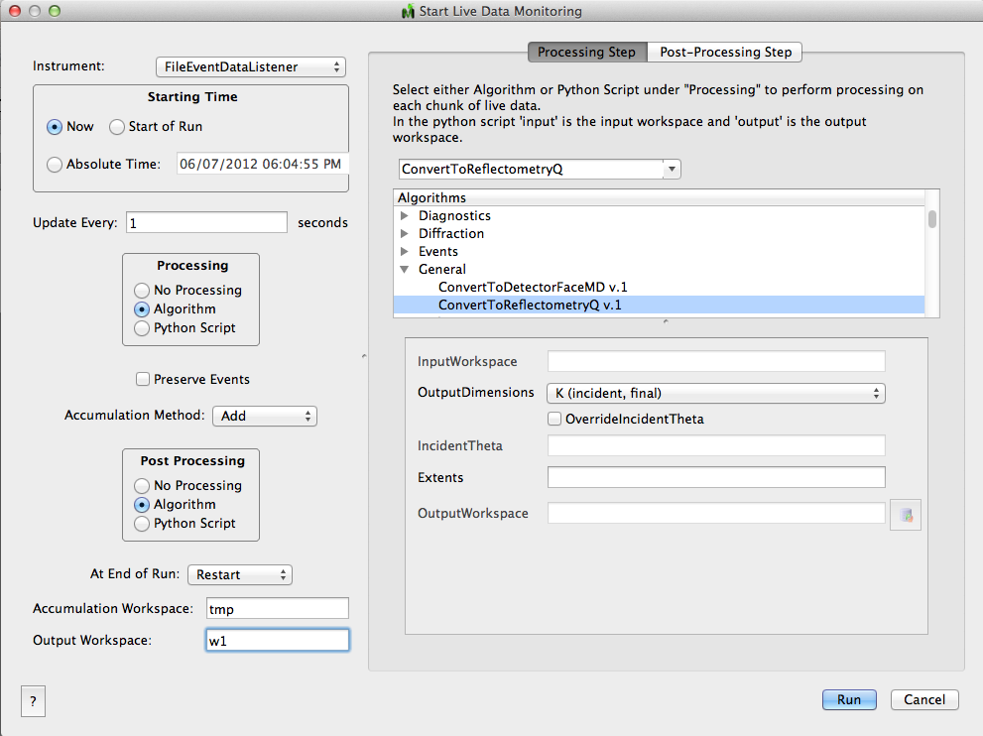
Notes:
Can handle change over between runs

Slide 45
Demo – BASIS S(Q,ω)

Slide 46
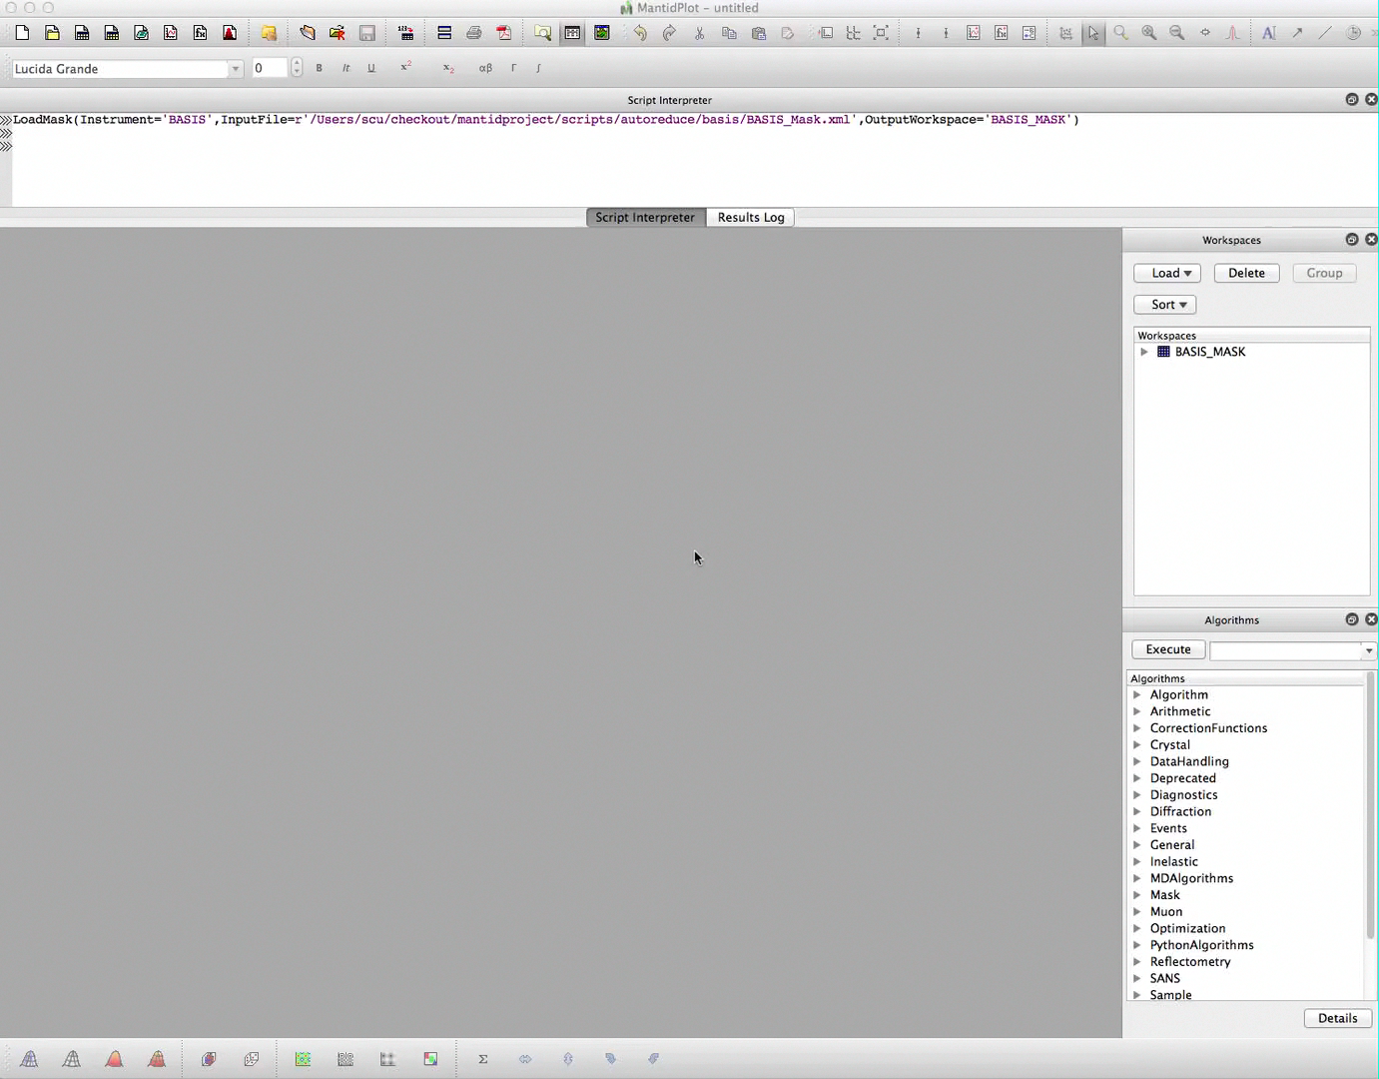
Notes:
Video showing basis data replay
…process (python script) -> I(angle, w)
…post process to S(Q,w)
Showing updating plot, multiplot, slice viewer (live cut)

Slide 47
Parallel Data Reduction
Presented to
SNS/ESS Workshop on Opportunities for Accelerating Neutron Data Analysis
Ross Miller National Center for Computational Science
June 28, 2012

Slide 48
Current Situation
Large datasets take too long to reduce
Some datasets are too large to fit in most computers’ memory
Imperfect solution: Have specific analysis machines with fast CPU’s and lots of RAM.
Having to log in to a specific machine is annoying
No scheduling: two users can log in simultaneously
Reduction is still slow

Slide 49
Parallel Advantages
Most reduction tasks are easily parallelizable
Much more available RAM and CPU power (obvious)
Parallel computer can mount the high speed filesystem directly
Only the reduced data needs to be transferred back to the analysis computer
Scientists can work from their laptops or remote sites

Slide 50
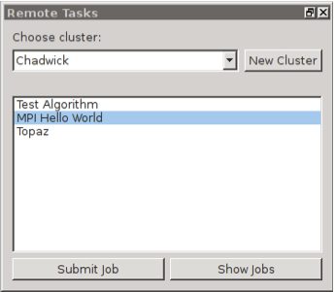
Architecture
Cluster uses MOAB for scheduling
MOAB Web Services enables remote computers to submit jobs
Config file on the cluster describes jobs that can be run (and parameters they need)
MantidPlot fetches this config file on startup
MantidPlot GUI supports multiple clusters
Connection details stored in the user’s prefs file
User selects job from MantidPlot GUI
MantidPlot sends request to schedule the job. Periodically polls to get the job status.

Slide 51
Architecture Details
Makes use of MOAB web services (new feature in 7.0)
MWS only knows about admin account
Uses HTTP Basic Auth, so HTTPS is pretty much a requirement
User Authentication/Authorization is handled externally
Custom (but fairly simple) PHP scripts call out to LDAP server. If permission in granted, the PHP scripts pass the job request on to MWS
Requests are HTTPS POST or GET
Data is encoded as JSON objects
Data representation is custom to MWS

Slide 52
Initial Performance Numbers
Note that none of these curves show times for single core. These datasets were actually too big for the memory of a single node.

Slide 53
Future Work
Need to be able to download results back to MantidPlot automatically (or at least with a simple button click)
Right now, have to manually transfer the results via scp or similar
High priority. Not really usable until this feature is implemented
Want to be able to submit python scripts for running on the cluster
Will probably use a different GUI – something with a text editor window, but will use the same infrastructure (MWS, LDAP, PHP, etc…)

Slide 54
Acknowledgments
Streaming data acquisition, translation, and reduction capabilities have been funded by DOE Laboratory Directed Research and Development (LDRD) Director’s R&D Fund project D12-037
Parallel data analysis capabilities have been funded by DOE Office of Basic Energy Sciences

Slide 55
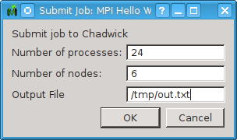
Screen Shots
LDAP Server
MantidPlot
PHP Code
(Apache httpd)
MWS
(Apache Tomcat)

Slide 56
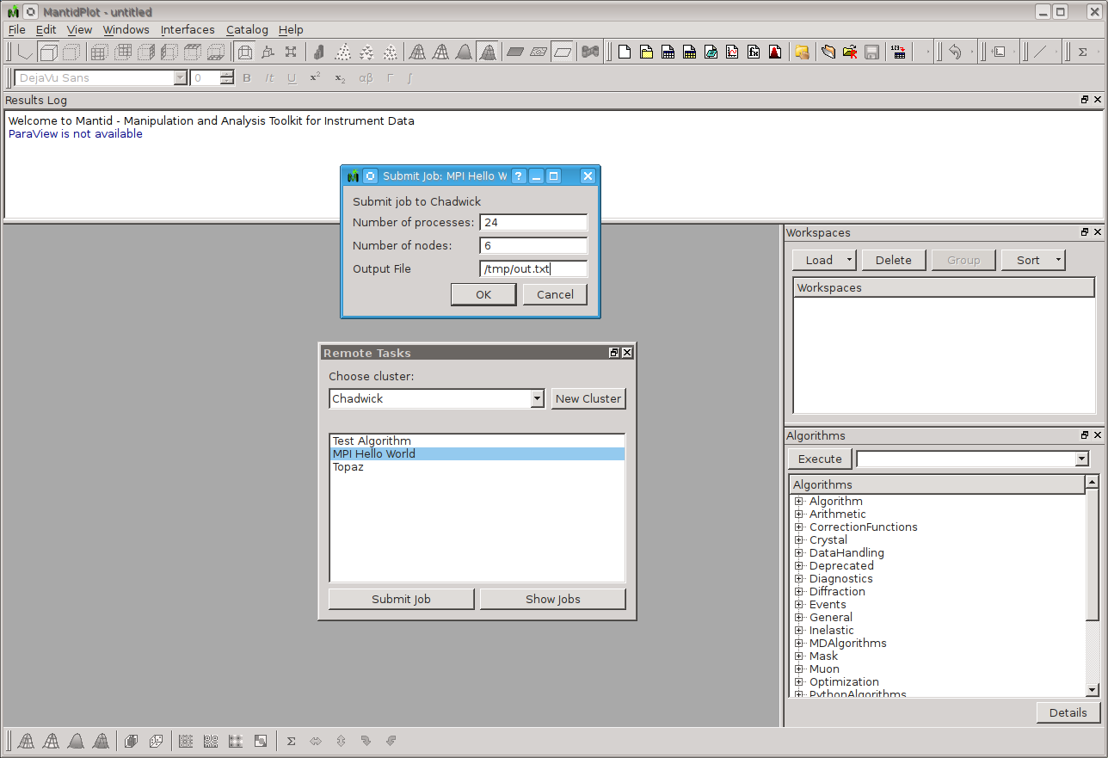

Slide 57
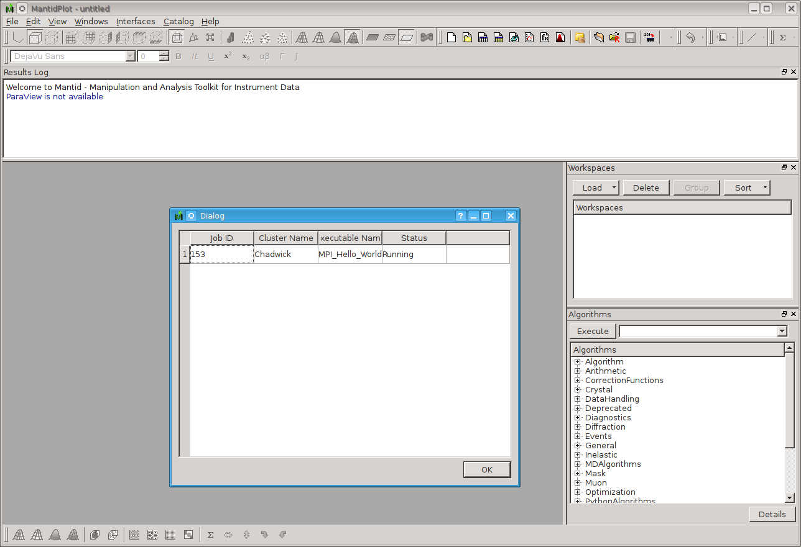

Slide 58
